Slide 1
Lecture Overview
What is a transistor?
  Uses
  History
  Background Science
Transistor Properties
Types of transistors
  Bipolar Junction Transistors
  Field Effect Transistors
  Power Transistors

Slide 2
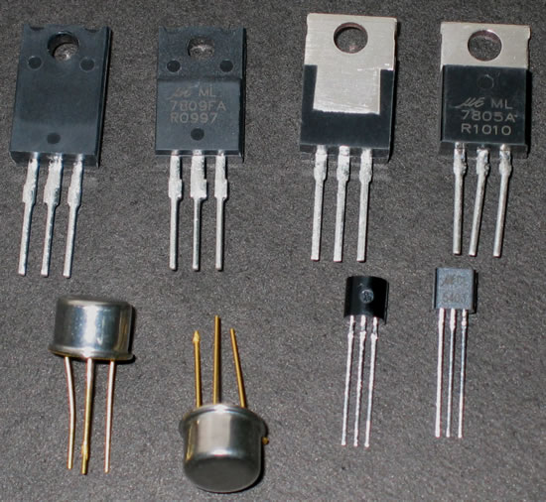
What is a transistor?
A transistor is a 3 terminal electronic device made of semiconductor material.
Transistors have many uses, including amplification, switching, voltage regulation, and the modulation of signals

Slide 3
History
Before transistors were invented, circuits used vacuum tubes:
  Fragile, large in size, heavy, generate large quantities of heat, require a large amount of power
The first transistors were created at Bell Telephone Laboratories in 1947
  William Shockley, John Bardeen, and Walter Brattain created the transistors in and effort to develop a technology that would overcome the problems of tubes.
  Shockley, Bardeen, and Brattain had referenced this material in their work

Slide 4
History
The word “transistor” is a combination of the terms “transconductance” and “variable resistor”
Today an advanced microprossesor can have as many as 1.7 billion transistors.

Slide 5
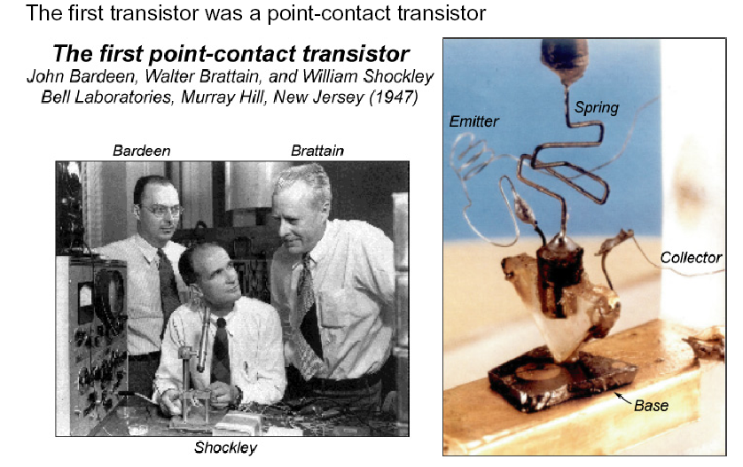
Point-Contact Transistor –
first transistor ever made

Slide 6
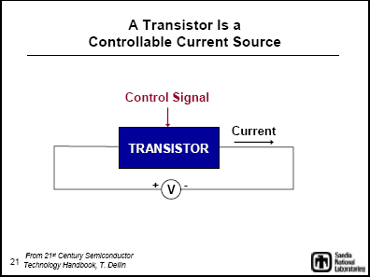

Slide 7
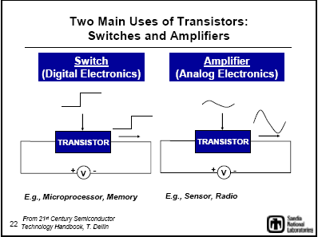

Slide 8
BJT Transistors
BJT (Bipolar Junction Transistor)
  npn
    Base is energized to allow current flow
  pnp
    Base is connected to a lower potential to allow current flow
3 parameters of interest
  Current gain (β)
  Voltage drop from base to emitter when V_{BE}=V_{FB}
  Minimum voltage drop across the collector and emitter when transistor is saturated

Slide 9
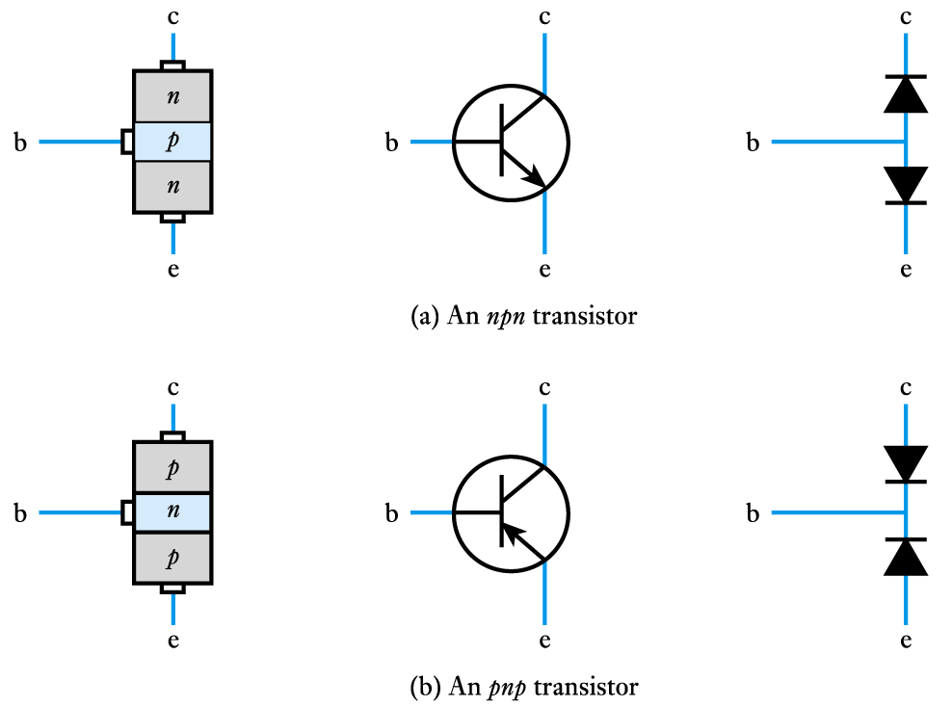
Construction
  two polarities:
  npn and pnp

Slide 10
Architecture of BJTs
There are two types of BJTs, the npn and pnp
The two junctions are termed the base-emitter junction and the base-collector junction
The term bipolar refers to the use of both holes and electrons as charge carriers in the transistor structure
In order for the transistor to operate properly, the two junctions must have the correct dc bias voltages
  the base-emitter (BE) junction is forward biased(>=0.7V for Si, >=0.3V for Ge)
  the base-collector (BC) junction is reverse biased

Slide 11
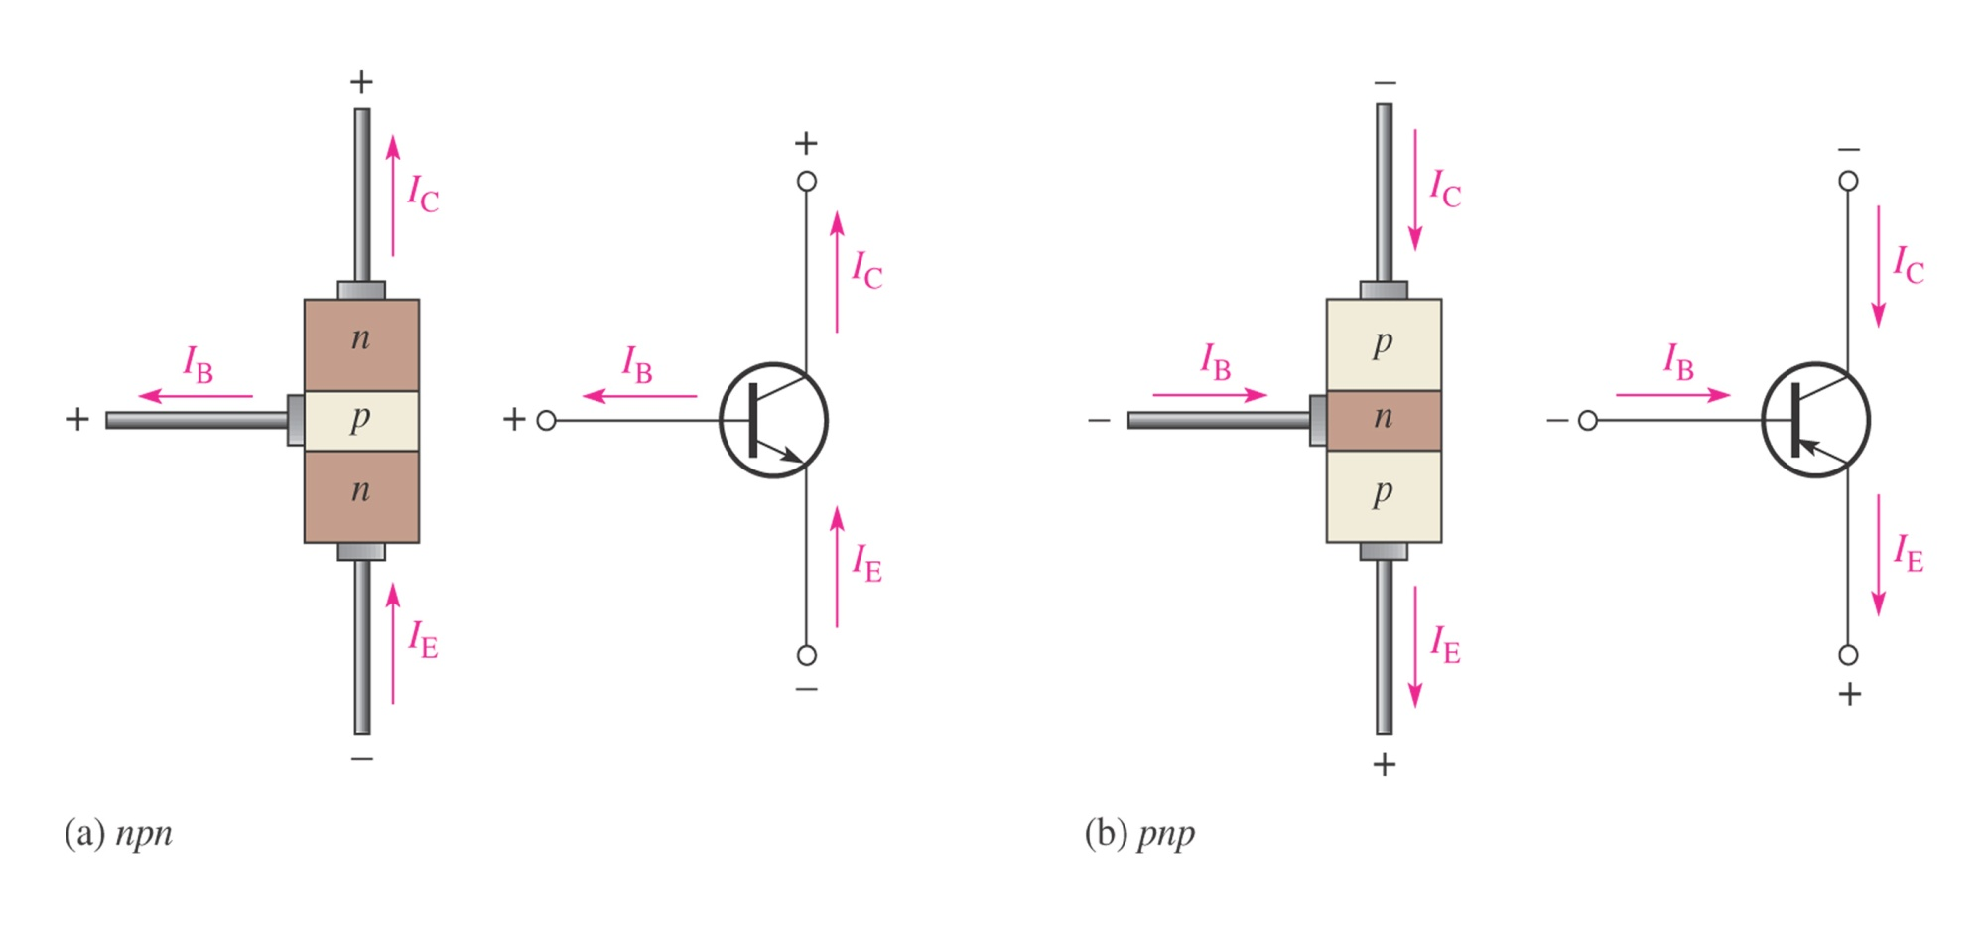
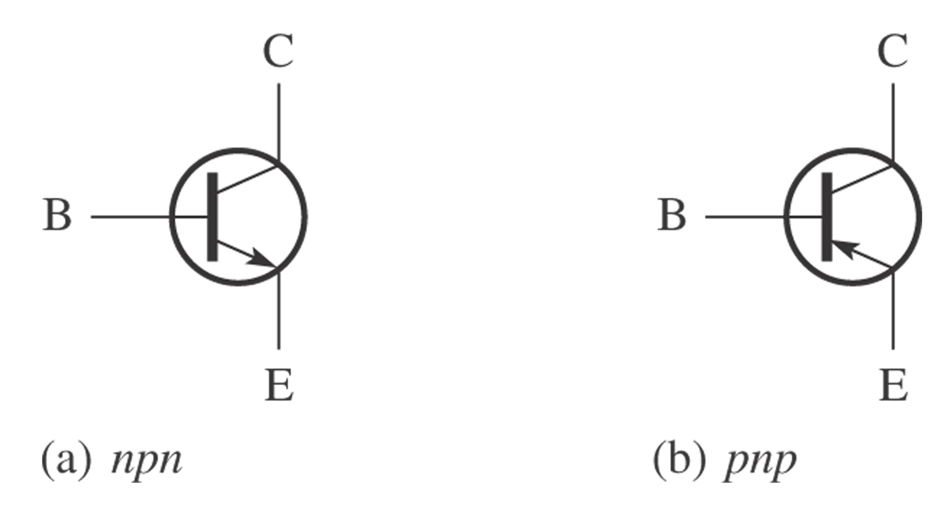
FIGURE Transistor symbols.
Thomas L. Floyd
Electronics Fundamentals, 6e
Electric Circuit Fundamentals, 6e
Copyright ©2004 by Pearson Education, Inc.
Upper Saddle River, New Jersey 07458
All rights reserved.

Slide 12
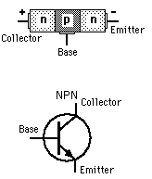
npn BJT Transistors
High potential at collector
Low potential at emitter
Allows current flow when the base is given a high potential

Slide 13
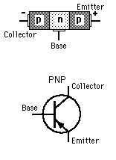
pnp BJT Transistors
High potential at emitter
Low potential at collector
Allows current flow when base is connected to a low potential

Slide 14
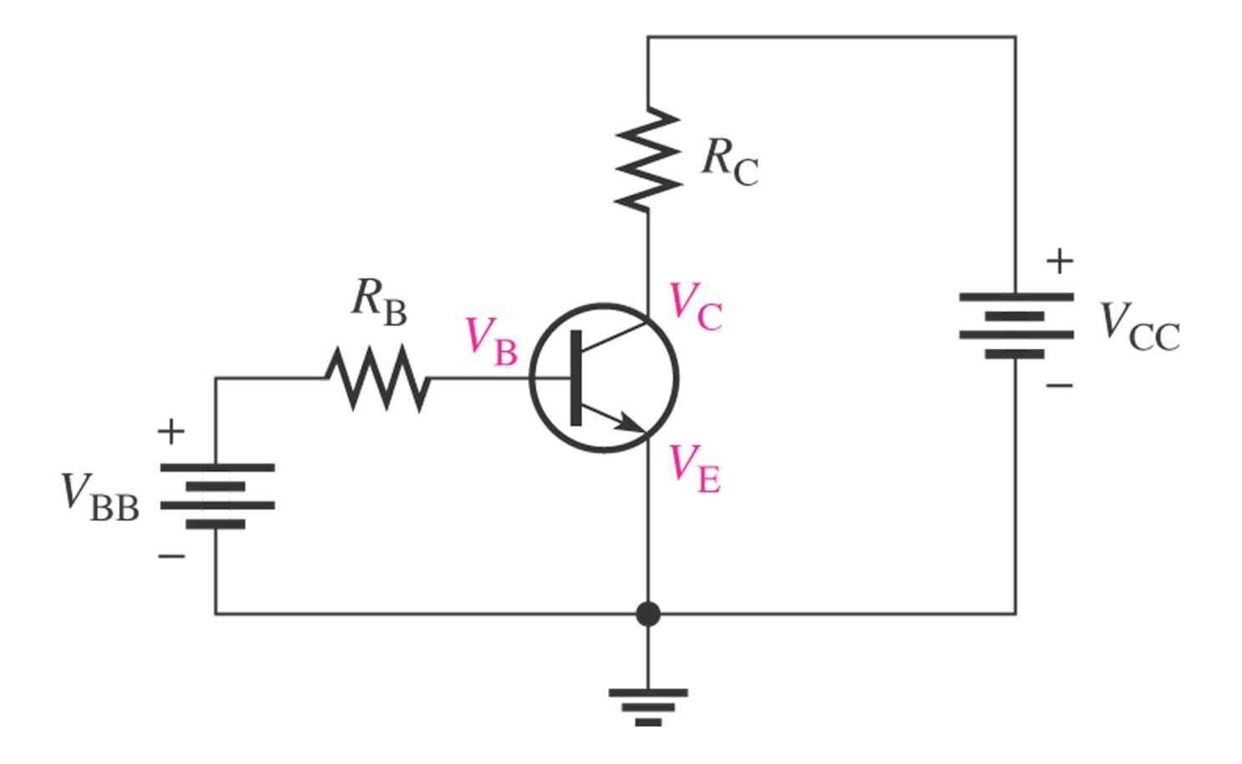
Basic circuits of BJT

Slide 15
DC Analysis of BJTs
Transistor Currents:
I_{E} = I_{C} + I_{B}
alpha (α_{DC})
I_{C} = α_{DC}I_{E}
beta (β_{DC})
I_{C} = β_{DC}I_{B}
  β_{DC} typically has a value between 20 and 200

Slide 16
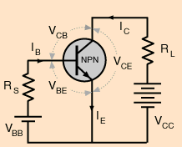
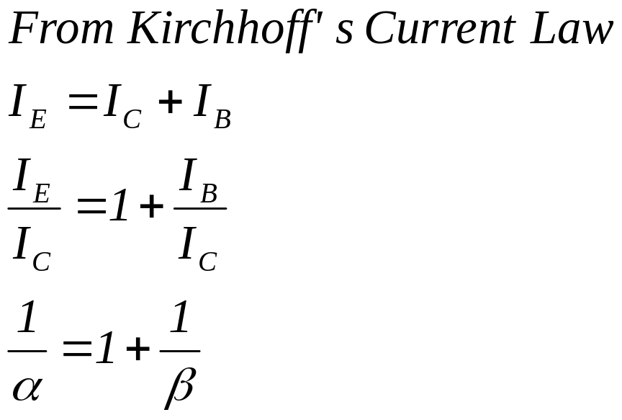
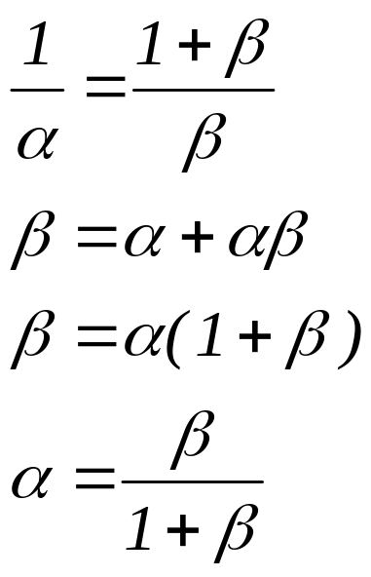
Current Gains
Common Base
  α = I_{C}/I_{E} < 1
Common Emitter
  β = I_{C}/I_{B}

Slide 17
Example
If β = 50, then α = 50/51 = 0.98
  Recall α < 1
Rearranging,
  β = α + αβ
  β(1-α) = α
  β = α/(1-α)

Slide 18
DC  and DC α
 = Common-emitter current gain
α = Common-base current gain
 = I_{C} α = I_{C}
I_{B} I_{E}
The relationships between the two parameters are:
α =   = α
 + 1 1 - α
Note: α and  are sometimes referred to as α_{dc} and _{dc} because the relationships being dealt with in the BJT are DC.

Slide 19
DC Analysis of BJTs
DC voltages for the biased transistor:
Collector voltage
V_{C} = V_{CC} - I_{C}R_{C}
Base voltage
V_{B} = V_{E} + V_{BE}
  for silicon transistors, V_{BE} = 0.7 V
  for germanium transistors, V_{BE} = 0.3 V

Slide 20
Operation of BJTs
BJT will operates in one of following four region
  Cutoff region (for digital circuit)
  Saturation region (for digital circuit)
  Linear (active) region (to be an amplifier)
  Breakdown region (always be a disaster)

Slide 21
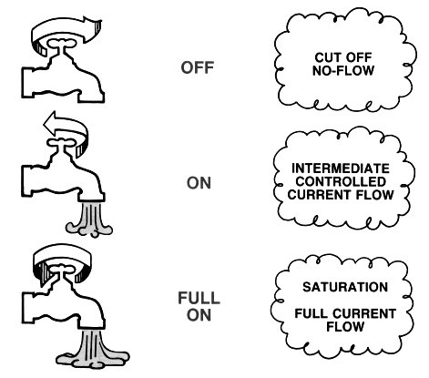
Transistor Operation
“Amplification” aspects of a transistor

Slide 22
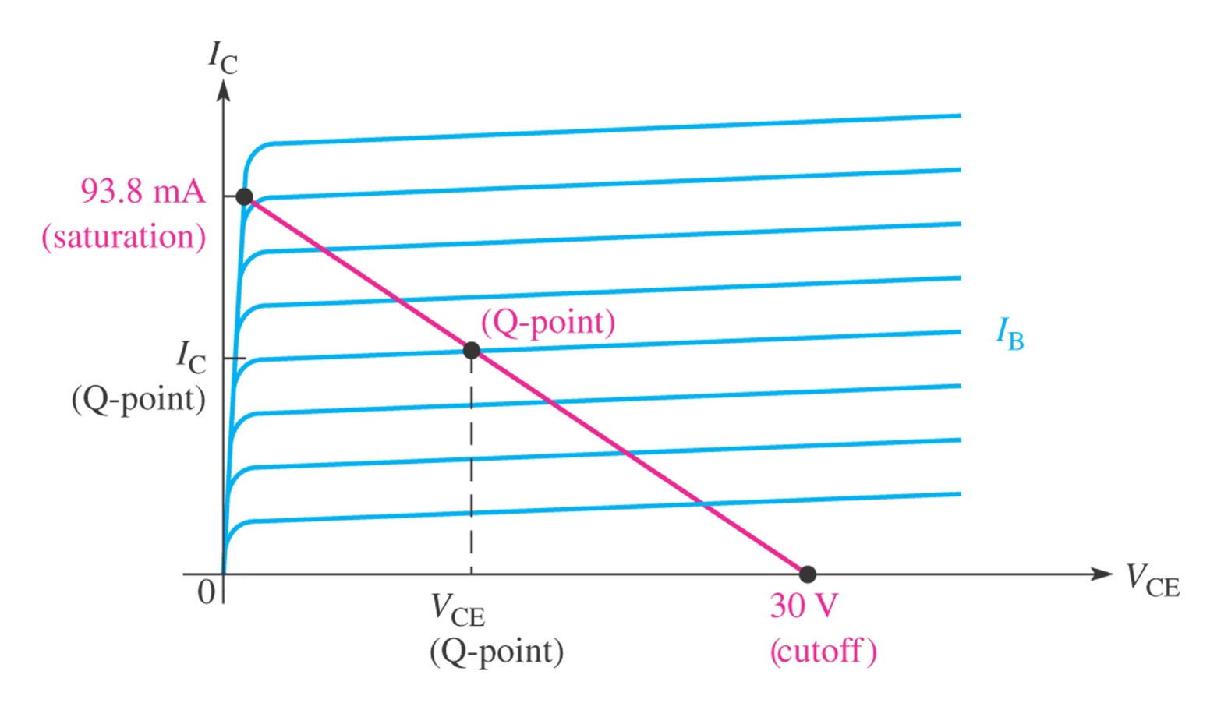
Q-point

Slide 23
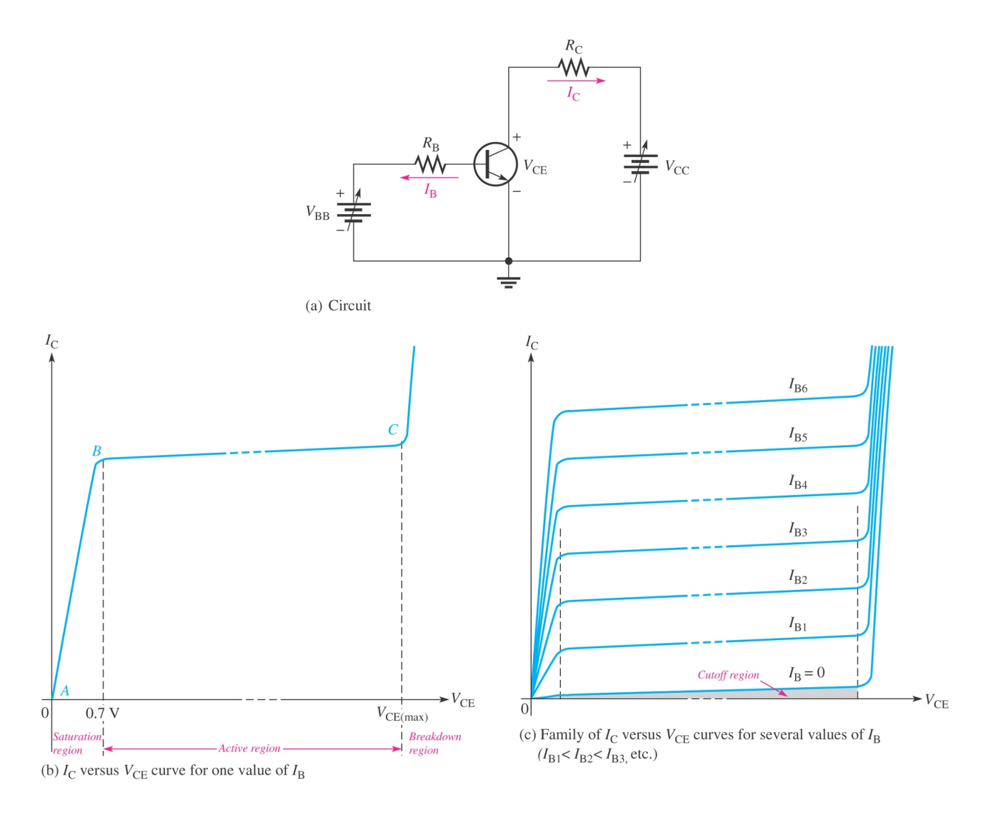
Operation of BJTs

Slide 24
FET Transistors
Analogous to BJT Transistors
FET Transistors switch by voltage rather than by current
BJT | FET
Collector | Drain
Base | Gate
Emitter | Source
N/A | Body
D
G
S

Slide 25
FET Transistors
FET (Field Effect Transistors)
  MOSFET (Metal-Oxide-Semiconductor Field-Effect Transistor)
  JFET (Junction Field-Effect Transistor)
  MESFET
  HEMT
  MODFET
Most common are the n-type MOSFET or JFET

Slide 26
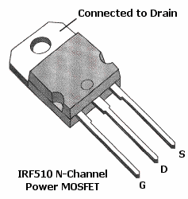
FET Transistors – Circuit Symbols
MOSFET
In practice the body and source leads are almost always connected
Most packages have these leads already connected
D
D
G
B
G
B
S
S
JFET
D
G
S

Slide 27
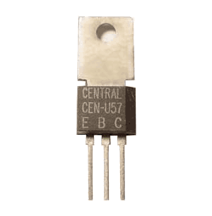
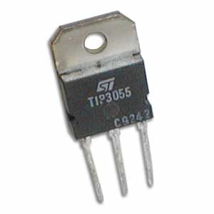
Power Transistors
Additional material for current handling and heat dissipation
Can handle high current and voltage
Functionally the same as normal transistors

Slide 28
Transistor Uses
Switching
Amplification
Variable Resistor

Slide 29
Transistor as a Switch
Transistors can be used as switches.¹
Transistor
Switch
Transistors can either
conduct or not conduct current.²
ie, transistors can either be on or off.²

Slide 30
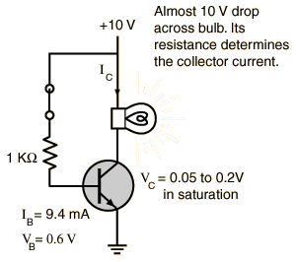
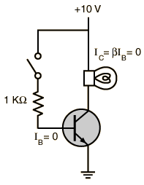
Using the transistor as a switch
Bulb off
Bulb on

Slide 31
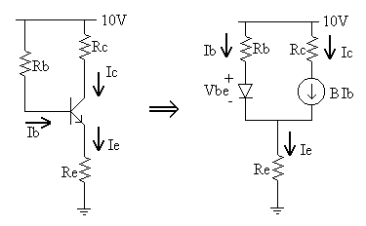
Transistor as an amplifier:
Transistors are often used as amplifiers to increase input signal in radios, televisions and some other applications .The circuit may be designed to increase the current or voltage level.
The power gain is the product of current gain and voltage gain (P=V*I).

Slide 32
Advantages
The key advantages that have allowed transistors to replace their vacuum tube predecessors in most applications are
Small size and minimal weight, allowing the development of miniaturized electronic devices.
Low operating voltages compatible with batteries of only a few cells.
No warm-up period for cathode heaters required after power application.
Lower power dissipation and generally greater energy efficiency.
Higher reliability and greater physical ruggedness.
Extremely long life. Some transistorized devices have been in service for more than 50 years.

Slide 33
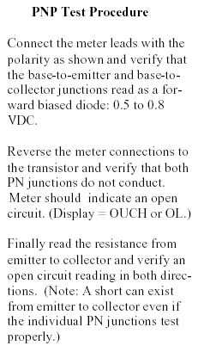
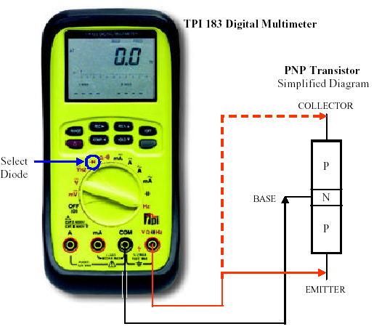
BJTs – Testing

Slide 34
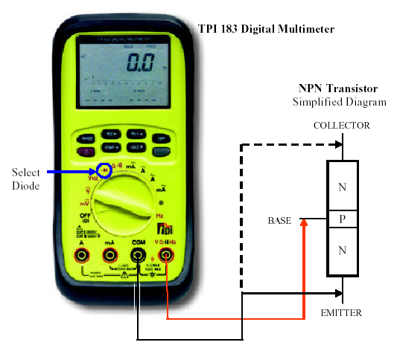
BJTs – Testing

